Slide 1
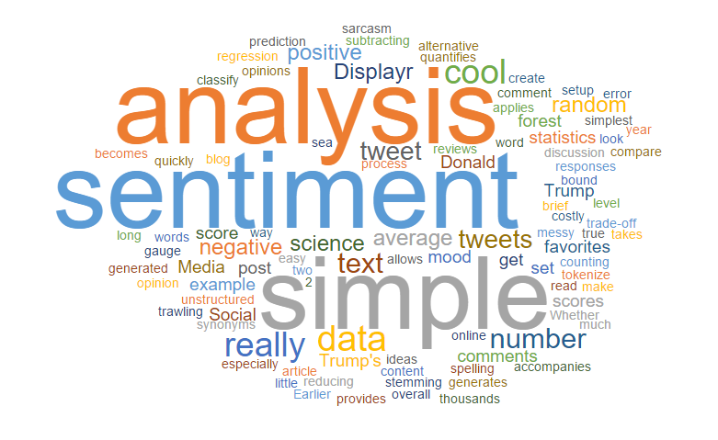
ENHANCING SENTIMENT ANALYSIS THROUGH NATURAL LANGUAGE PROCESSING (NLP)
By
ALISHA RATH
SJSU
MS CS

Slide 2
OUTLINE
Introduction
Key Research Works
Research Focus
Findings and future direction

Slide 3
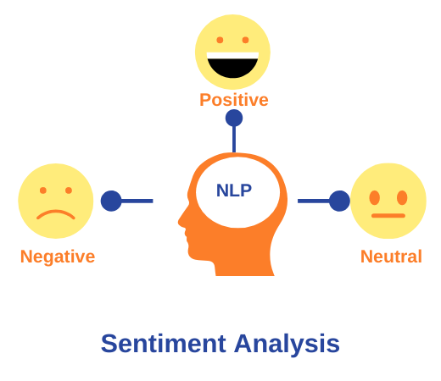
What is Sentiment Analysis
Definition: Study of emotional tones within text
Traditional methods lack – understanding sarcasm, cultural variation

Slide 4
KEY RESEARCH WORKS
Mass A. L.’s paper - importance of distributed word representations
Socher R.’s paper - introduced recursive deep models

Slide 5
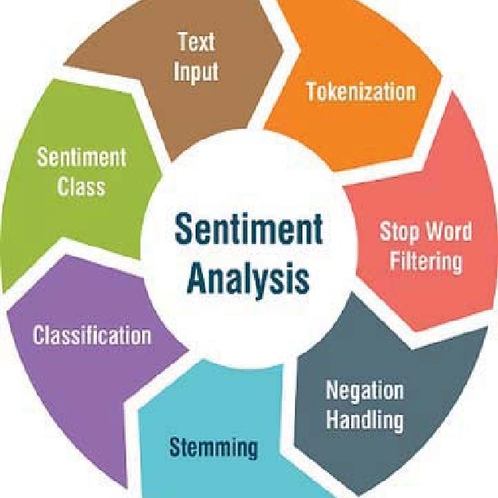
Research FOCUS
Revolutionize sentiment analysis by leveraging the power of NLP
word embeddings for sentiment analysis like Word2Vec and GloVe embeddings

Slide 6
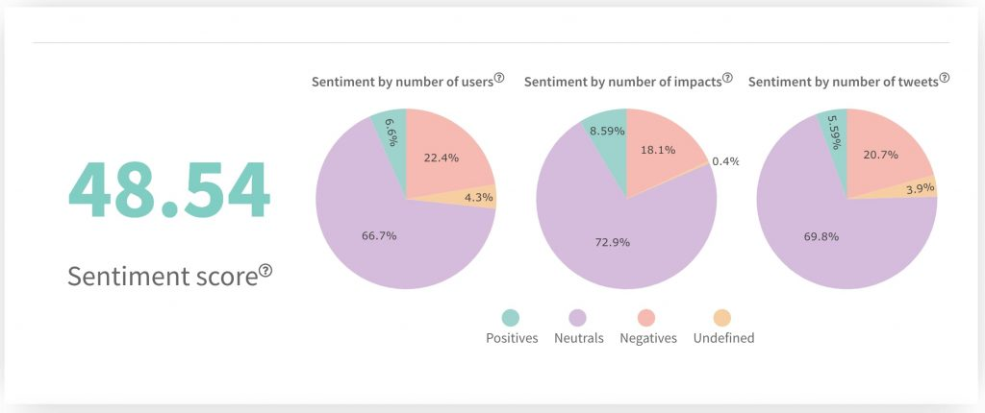
EXAMPLE: twitter election feedback

Slide 7

Findings and Future Directions
contextual interpretation
handling sarcasm
adapting to multi-modal and multilingual expressions

Slide 8
THANK YOU !

